Slide 1
ICAO and General Aviation
IAOPA World Assembly Queenstown, NZ 25 - 29 March 2018
Arun Mishra
Regional Director Asia Pacific
Notes:
Good Afternoon ladies and Gentlemen. You have heard the Secretary General of ICAO and I donot think ICAO needs any introduction. The important thing I would like to mention that ICAO is not a regulatory organization. Rather, it facilitates consensus among its member states for the development of SARPs, which form the basis for actions by states to implement procedures, practices, services, facilities and regulations that will meet the objective of the standard or recommended practice. In this regard, ICAO seeks to enhance harmonization that will enhance the ability of aviation operations to be conducted internationally.

Slide 2
Plan of this presentation
Overview of Global Aviation
General Aviation: Challenges
Safety Issues
Recent ICAO amendments
Way Forward
Notes:
My presentation would provide a brief overview of Global aviation and then touch upon GA and its challenges including safety issues. I would like to then talk about a few recent ICAO amendments impacting GA and then conclude wth some thoughts on how to move forward.

Slide 3
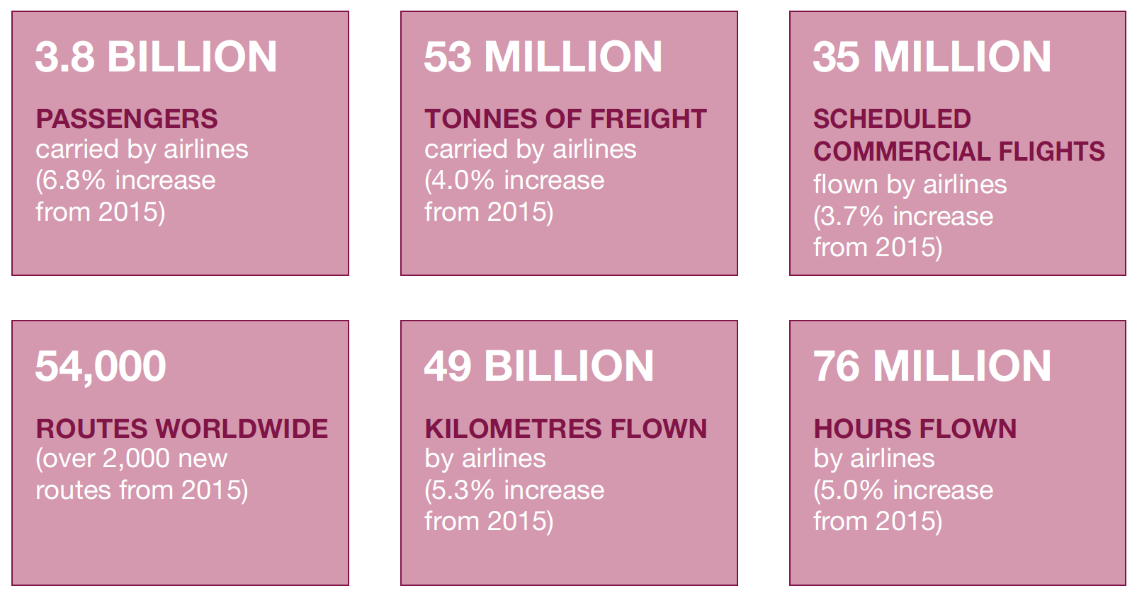
A Global Picture
4.1 BILLION
PASSENGERS
carried by airlines (7.1% increase from 2016)
Source: Aviation Benefits 2017 (https://www.icao.int/sustainability/Pages/IHLG.aspx)
Notes:
What you see here is a snapshot of the high-level statistics of aviation as a whole. The ICAO Secretary General has mentioned these benefits and I would like to echo their message by emphasizing the importance of civil aviation in supporting social and economic development worldwide.
Just briefly, you will see here key figures on the extent aviation benefits us all:
62.7 Million jobs were supported by aviation
Aviation supported 3.5 percent of GDP
Aviation’s economic impact is $2.7 trillion
[Click 1] And most recently, we’ve seen a 7.1% increase in passengers carried by airlines from 2016, to 4.1 Billion. What this increase means is that the figures I quickly mentioned before would also increase, proving that aviation’s contribution to the socio-economic welfare of the world is significant and continues to increase.

Slide 4
Growth of Air Transport
+3.8%
vs. 2015
205 billion FTK
+7.4%
growth rate vs. 2015
7.1 trillion RPK
Source: ICAO Annual Report of the Council
Scheduled commercial traffic
Total (international and domestic) services
Notes:
Aviation and its associated benefits are growing at an incredible pace. What’s more impressive is that growth, historically, is not at all hindered by crisis, war or economic recession, as you can see in this chart.
Now, while this continued and expected growth bring about tremendous opportunities for all stakeholders around the world, it also poses a unique challenge - How can we ensure that all of us can support this growth? And, how can we ensure that we can maintain the enviable safety record we currently enjoy?

Slide 5
ZERO FATALITIES
Our Aspirational Safety Goal
Notes:
So, while we face this growth, we remain optimistic, as the way ahead is littered with incredible opportunities
Our aspirational safety goal is to have no loss of life attributed to aviation – which again, will only get more challenging as we continue to put more fights in the air and safely on the ground.

Slide 6
We are not that far…
Regional Accident Statistics: 2013
Regional Accident Statistics: 2015
For 2017 (non-validated results)
MID and AFI
(APAC 2 – PA 1)
ZERO fatalities
Regional Accident Statistics: 2014
Regional Accident Statistics: 2016
Notes:
In this context, we are actually not far in reaching this aspirational goal, as several regions have already recorded years without a single fatality on scheduled commercial flights.
For the year 2017, preliminary figures show that the African and Middle East Regions had zero fatalities/
Two fatalities were recorded in Asia Pacific and one in the Pan-American Region.

Slide 7
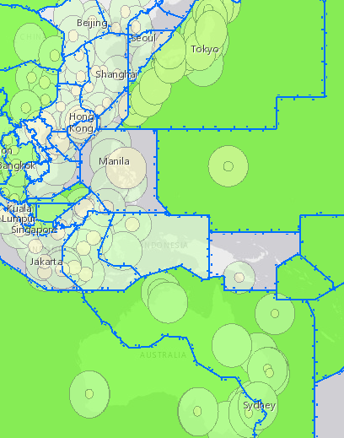
Other Challenges
What’s next?
Mental Health
UTM & FL600+
Cargo Safety
Supersonic aircraft
Conflict Zones
Global Tracking
Cyber Safety
RPAS
Space Transportation
Notes:
This slide talks about our new and emerging challenges, which continue to increase in complexity and scope.
We’re all familiar with most of these, but what I would like to hear from you is what you think would be next
Whatever challenge we have in front of us, emerging or otherwise, it is only by the involvement of ALL Stakeholders, can we resolve these challenges.

Slide 8
GA Issues
One size does not fit all
Require cost-benefit analyses for all proposed standards, especially for operations other than commercial air transport.
Provide equitable access to airspace and aerodromes for GA.
Mandate collection of general aviation census, utilization of accident/incident statistics by both ICAO and States
Notes:
While most of you are aware of these GA issue I would like to highlight them as they are still very relevant to most of us:
The principle that one-size does not fit all is still not internalized by many of the stakeholders including regulators for bringing about a differentiated approach to regulation of general aviation and commercial air transport operations.
Recognition throughout the ICAO Annexes of the separate needs and capabilities of general aviation vis-à-vis commercial air transport operations. Introduction of any new standards should be preceded by a comprehensive cost benefit analysis for the GA sector especially in view of the complexity of its diverse operations
Slots at airports is a big challenge especially for multi use busy airports. GA by its very nature of operation can not have fixed schedule posing a challenge to accommodate them at these airports. Increasing Congestion of air space has led to several initiatives to streamline and optimize airspace use like RVSM. These airspace are restricted for non-RVSM capable aircraft.
Planning of future operations, safety initiatives as well development planning for infrastructure is hampered by lack of data and statistics on GA as compared to Commercial aviation which is readily available. To progress systematically ICAO, States and Operators need to collaborate to build a data base for this sector.

Slide 9
A safety issue
Notes:
I would like to focus on one safety area which is of concern in GA and where we need to invest for improvements.

Slide 10
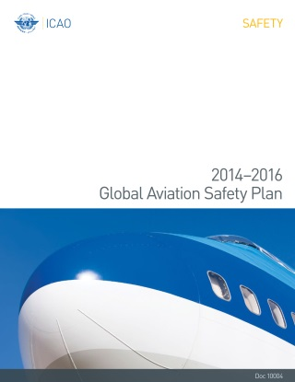
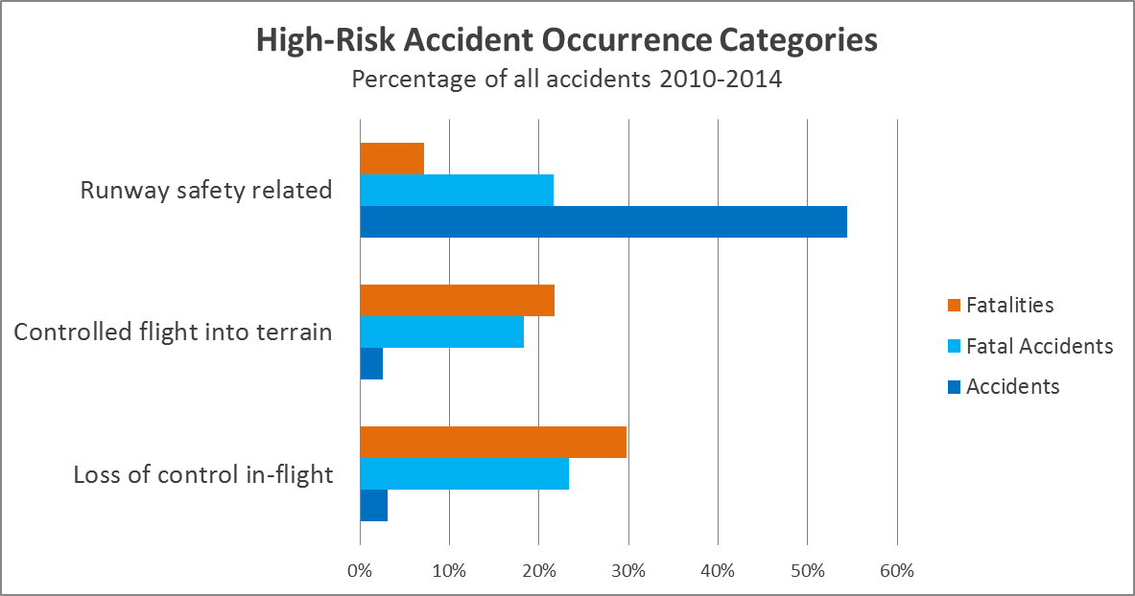
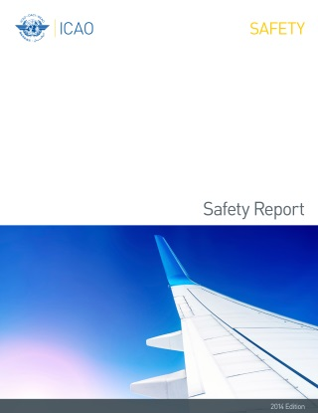
ICAO Top 3 Safety Priorities
Notes:
The highest-risk occurrence categories for accidents, they remain to be related to Runway Safety, Loss of Control in-flight, and Controlled flight into terrain.
Runway safety related accidents continue to result in low numbers of fatalities, despite having the highest percentage of accidents
While the loss of control in-flight occurrence category represented only 3% of all accidents, this category is of significant concern as it accounts for 33% of all fatal accidents and 52% of all fatalities (the highest by proportion).
Controlled-flight into terrain accidents were responsible for 12% of fatal accidents .
LOC I has made it to one of ICAO’s top safety priorities due to its fatalities

Slide 11
Loss of control in flight (LOC-I)
ICAO ADREP database is not capturing all GA accident data (MTOM >= 2250 kg)
LOC-I – The Main Cause of GA Fatal Accidents (EASA – 2017).
Most wanted list of safety improvements (NTSB – 2017): Prevent LOC-I in GA.
Notes:
While we in ICAO donot have all the stats concerning GA accidents especially the low weight category it is well recognized for GA that LOCI is recognized as a a main cause of fatal accidents and also features in the most wanted list of Safety Improvements by NTSB

Slide 12
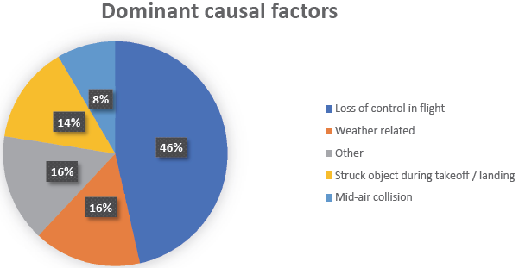
Loss of control in flight (LOC-I)
U.K. AAIB Annual Safety Review 2017: GA fatal accidents
Notes:
The UK AAIB annual safety review for 2017 also lists LOC as a cause of 46% of fatal GA Accidents.

Slide 13
ICAO work to mitigate LOC-I
Mainly addressed to commercial air transport
Uses UPRT as a means of mitigation – mandated for MPL, type rating and airline training, recommended for CPL (Annexes 1 and 6)
Guidance material published
Notes:
Mitigating loss of control in-flight accidents is an ICAO Safety Priority •
Upset prevention and recovery training (UPRT) for pilots is one means to address this priority.
The ICAO SARPS state that Pilots must be trained in upset prevention and recovery in order to meet: –
Licensing requirements for CPL and MPL •
MPL must receive on-aircraft UPRT to be conducted by an ATO
CPL should receive on-aircraft UPRT to be conducted by an ATO –
Licensing requirements for multi-crew type-rating –
Commercial air transport pilot training programme requirements •
The SARPs are applicable since Nov 2014

Slide 14
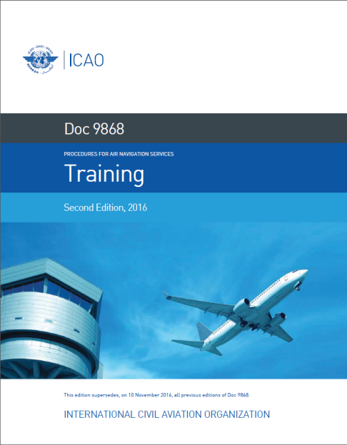
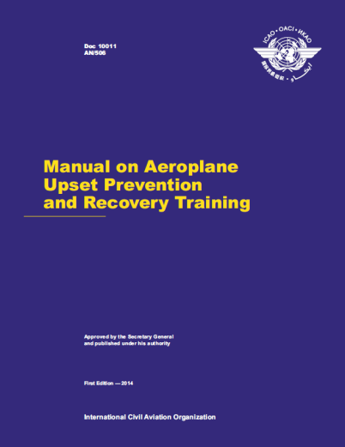
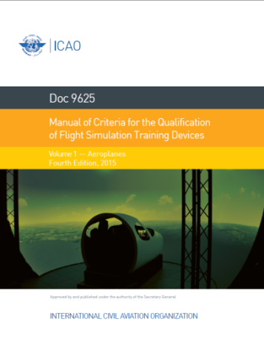
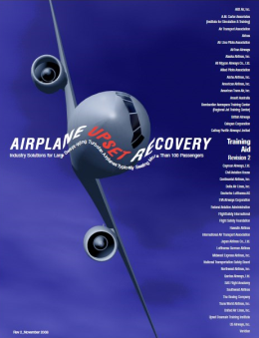
Existing guidance material on UPRT
Notes:
Four guidance documents were either published or updated by ICAO to support upset prevention and recovery training:
PANS-TRG
Doc 10011 ….
Doc 9625, Volume I
Revision 3 of the Airplane Upset Prevention and Recovery Training Aid

Slide 15
Recent ICAO Amendments impacting GA
RUNWAY SURFACE CONDITION – GLOBAL REPORTING FORMAT
NEW PBN CHART NAMING AND OPERATIONAL APPROVAL
SAFETY MANAGEMENT, ANNEX 19
Notes:
The recent changes to ICAO annexes in this slide is not an exhaustive list. Instead, these items represent the changes most relevant to business aviation.
Changes are being made to Annexes 3, 8, 11, 14 and 15 seeking to implement a standardized global format for assessing and reporting runway surface conditions. It is expected that most states will implement this format using “SNOWTAMs,” specialized NOTAMs notifying pilots of potentially hazardous conditions due to the presence of snow, ice, slush or standing water during winter operations. For General Aviation Operations – new operations standards are developed for large and turbojet airplanes but as a recommendation only.
These amendments are significant efforts because they require state-coordinated efforts between airports, manufacturers, navigation services and operators,”
Amendments to Annex 6 Part II updating PBN provisions were adopted on March 2, 2016 and became applicable on Nov. 10, 2016. These new Standards facilitate the operational approval for PBN operations. They basically allow a State to establish the criteria pilots and operators need to follow for the majority of PBN approach operations. For the “Authorization Required” (RNP -AR) a letter of authorization template was introduced to facilitate the specific approval.
ICAO has been working hard to make PBN the norm rather than the exception, ICAO Document 8168, Procedures for Air Navigation – Aircraft Operations (PANS OPS) Amendment 6 dated November 2014, introduced a new chart identification convention for Performance-Based Navigation (PBN) approach procedures. The amendment changed PBN approach procedure chart identification from RNAV to RNP. A chart naming transition was established to minimize the impact on States and stakeholders. The transition ends in November 2022. A key benefit of this PBN approach name change is that it will make chart identification more intuitive and better aligned with the approval process. A couple of weeks ago ICAO issued a new Circular (353) that will help States with this transition.
Annex 19 saw its first significant set of amendments in 2016, although most changes are addressed to the member state’s state-required safety management systems (SMS) programs.
In addition to changes directed at state SMS programs, changes affecting operators have also been introduced. Specifically, 4.2 International General Aviation – Aeroplanes – requires “the SMS of an international general aviation operator, conducting operations of large or turbojet aeroplanes, to be commensurate with the size and complexity of the operation and meet the criteria established by the state of registry.”

Slide 16
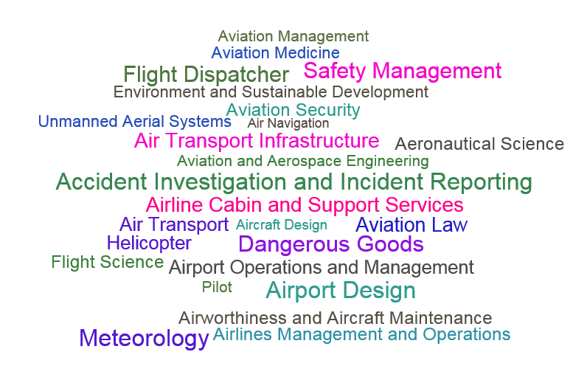
Notes:
I would like to point out a major concern for GA sector i.e the human resources.
Boeing predicts global aircraft deliveries of 41000 aircraft between now to 2036. With these additional aircrafts the challenge of getting the qualified technical manpower to operate and maintain these aircraft is a huge issue. Further to complement the aircraft operations we need augmentation in the other areas like airports, Air Traffic controls, ground handling, security etc. You can see the plethora of professional required with different skills in this slide. The existing human resources is not at all capable to support this major expansion. While I do not have the segregated figures for the growth of GA in the coming years I am sure the numbers will be staggering.

Slide 17
NGAP & GA
GA faces a huge deficit of trained manpower which will increase with the projected growth
Business aviation is “hemorrhaging talent” as pilots leave the sector for airline careers.
Lack of information to young people regarding opportunities GA sector.
Notes:
Next Generation of Aviation Professionals NGAP is a program initiated by ICAO to sensitize various stakeholders regarding the upcoming manpower requirements and promote various strategies to attract and facilitate the new generation to join aviation. GA has been experiencing the shortage of technical manpower over the years. Given the complexity of so many different types of aircraft used by GA, the problem of nurturing and retaining qualified personnel becomes enormous. As you are fully aware Qualified technical personnel are not available Off the Shelf. A lot of investment of time and money is required to prepare qualified and experienced experts who can ensure safety and security of aviation systems.
There are serious implication of shortage of qualified employees, supervisors and managers in various positions in the general aviation industry and regulatory functions. If we follow business as usual strategy then very soon we would be forced to cut down our growth ambitions, reduce services as well as defer aircraft orders.
In the present scenario Trained personnel prefer to work for Commercial aviation hence migrate at the first opportunity. This needs to change systematically.
One key problem is the lack of information provided to young people regarding opportunities in the business aviation sector. They grow up thinking that professional aviation is all about working for the airlines. They’re not aware of the opportunities in business aviation. Schools and universities don’t have relevant programs. Business aviation need to be more visible and provide better opportunities to position itself as a career choice. The need to collaborate with regulators and training institutions to achieve this objective has become imminent and essential for GA.

Slide 18
GA vis-à-vis Regulators?
How can IAOPA progress GA issues
States lack resources for regulating based on risk assessment
IOPA Member associations should proactively engage with CAAs to:
Provide sufficient aviation infrastructure
Develop appropriate regulations – suited for GA
Support appropriate fee/tax structure and other fiscal measures
Collaborate on NGAP
Notes:
The growth of the business aviation industry signals the need for an effective regulatory framework to sustain this growth and address challenges that are impeding it. Noticeable challenges in the industry concern, among other things:
funding;
inadequate infrastructure certification;
access to maintenance services and suitably qualified personnel;
the rising costs of aviation fuel;
taxation;
the effects of the foreign exchange crisis;
safety regulations;
labour issues; and
security.
Addressing the various challenges requires a more focused approach to policy making for the industry. States needs a comprehensive general aviation policy that defines the scope of oversight functions of regulatory agencies and sets out guidelines for private sector participation in order to stimulate investment in building airstrips and increasing local capacity for the maintenance, repair and overhaul of aircraft etc. Fluctuations in foreign exchange rates and the attendant effect on maintenance costs must also be examined in order to identify possible means of intervention by the government through the Central Bank and other relevant fiscal measures. Similarly, there is a need for a robust policy position on licensing and the identification of jets and helicopters used for business aviation, with a view to generate revenue and guarantee security and conformity with global standards without unduly stifling the operations of stakeholders through unnecessary bottlenecks.
A simplified and transparent approach is recommended to engender increased participation in the sector. All this needs effective and regular engagements between the Industry and the Policy makers in the government.

Slide 19
Way Forward
IAOPA and its Member organizations to participate in ICAO panels and expert groups:
Establish regular contact with the Regional Offices
Organize with ICAO a half day workshop for DGs of CAAs during the DGCA Conference in Fiji (Oct 2018)
Organize GA focused events in the region
Notes:
IAOPA and other affiliates have historically been engaged with the rule making process in ICAO through their participation though in a limited manner in the work of various expert panels and groups like the Flight Operations Panel, Air Traffic Management Operations Panel, Aerodrome Design and Operations Panel, RPAS Panel, AvSec panel etc. This participation needs to be enhanced and expanded. The expertise which resides in the GA sector needs to be shared in the Global as well as Regional platforms for proper appreciation of the specific needs and capabilities of GA.
At present I can say that IAOPA and its affiliates have very little engagement with the Regional Offices of ICAO. Since Regional Offices have direct linkage with the States it would be useful if there is a mechanism at the Regional level for interaction with IOAPA representatives so that the Regional Office can understand the operational difficulties relating to a particular State or a group of States for necessary intervention.
In the Asia Pacific region we have an annual meeting of all Heads of CAAs. I would like to offer to IAOPA and their associates to use this opportunity to have a direct interaction with the States in which the common issues of GA can be highlighted and the States can be sensitized through a workshop. This will be in Fiji in Oct 2018. We can discuss this further.
To promote GA issues there is also need to organize Regional events like seminars where partners from States, other International organizations can participate. The main idea is to bring GA issues on the main table for deliberations amongst relevant stakeholders.

Slide 21
PROPOSAL FOR NEXT GASP
Effective Implementation
BBBs
Operational Risks
States that need support in areas with safety margins below zero, to use a RSOO mechanism or another State’s ICAO-recognized functions
All States to improve their score for the effective implementation (EI) of the critical elements (CEs) of the State’s safety oversight system as follows:
By 2022 – 75%
By 2026 – 85%
By 2030 – 95%
All States to reach a positive safety margin, in all categories
All States to implement the foundation of a State Safety Programme (SSP)
All States to implement an Effective SSP, as appropriate to their aviation system complexity
All States to implement the air navigation and airport core infrastructure
Maintain a decreasing trend of global accident rate
Increase the number of service providers participating in the corresponding, ICAO-recognized industry assessment programmes
All service providers to use globally harmonized SPIs, as part of their safety management systems (SMS)
All States to contribute information on safety risks, including SSP safety performance indicators (SPIs), to their respective Regional Aviation Safety Groups (RASGs)
All States with a positive safety margin, and an Effective SSP, to actively engage in RASGs’ safety risk management activities
TARGET 4.1
TARGET 2.1
TARGET 2.2
TARGET 3.1
TARGET 3.2
TARGET 6.1
TARGET 1.1
TARGET 5.1
TARGET 5.2
TARGET 4.2
TARGET 4.3
ICAO Recognized functions
Implement Safety Oversight
Positive
Safety Margin
Sustainable SSP
Effective SSP
Appropriate
Infra-structure
Reduced Accident rate
INDUSTRY
assessment programmes
Harmonized KPIs in
SMS
Safety risk information to RASG
RASG
Risk mgmt. activities
2020
2022+
2022
2022
2025
2022
Yearly
2020
2022
2022
2022
Notes:
[DANB]
These series of goals and targets work towards supporting the aspirational goal of zero fatalities.
Specifically, the 2020-2022 edition of the GASP will contain six goals, some of which are derived from the three objectives contained in the previous, 2017-2019 edition of the GASP.
The 6 goals are:
Goal 1: Achieve a continuous reduction of operational safety risks.
Goal 2: Strengthen States’ safety oversight capabilities.
Goal 3: Effectively implement State safety programmes.
Goal 4: Increase collaboration at the regional level.
Goal 5: Increase the use of industry programmes.
Goal 6: Ensure the appropriate infrastructure is available to support safe operations
Each goal has one or several targets associated to it, as seen on this slide.
The GASP targets contain dates for the completion of different actions, and are to be used to measure the success of national and regional aviation safety plans and the GASP as a whole.
You will get a chance to hear more about this new edition of the GASP during the 13th Air Navigation Conference this year.

Slide 22
APAC at a Glance
Complexity
39 States, 40 CAAs & 42 Air Navigation Service Providers (ANSPs)
Economic Growth 2016
10.2% growth in Revenue Passenger Kilometer (RPK)
Threats
Natural Disasters (Earthquakes, Tsunami, Volcanoes, Tropical cyclones)
49 Flight Information Regions, Vast Oceanic Airspace
Global Market Share
Supports 30.9m jobs & GDP of $632b
Health threats (Avian Bird’s Flu, H1NI)
33% Passenger
39% Cargo
Financial Downturn
Diverse Aviation Capacity
Notes:
Coming to the distinguishing features of the region. Asia/Pacific remains the world’s largest region with a 33% share of total capacity and a very healthy growth. With 10.2 % growth rate it is estimated that this region will have more than 50% of global traffic within next 20 years. The rising middle class, low penetration of air travel, fast growth of LCCs, liberalization and opening of tourism and trade are few important factors which provide the essential ingredient for dramatic changes in the aviation scenario of the region in the coming years.
Apart from the huge diversity the region is the largest amongst ICAO regions both in terms of population as well as size. From Kabul in the west to Cook Islands in the east the distance is about 15000 kms. Similarly from Mongolia in North to New Zealand in south covers a distance of 12000 kms.
The region’s air transport industry supports 30.9 million jobs and $632 billion in Gross Domestic Product (GDP).
In 2016 Airlines in Asia and the Pacific increased their capacity in ASK (Available Seat-Kilometres) by +9.4%,
Cargo traffic performed by carriers of Asia and the Pacific constitutes 39% of global cargo traffic.
In short the region has become one of the biggest air transport markets in the world. Routes, frequencies, seat capacities, and number of destinations have increased significantly in recent years. One of the factors responsible for these is the liberalization policies adopted by countries in the region which include regional economic integration schemes and air transport liberalization programs. For example the establishment of the ASEAN Single Aviation Market aims at liberalizing air travel between its Member States will benefit the ASEAN airlines, boosting the growth of air travel as well as tourism, trade, investment and other service industries in the region.
In terms of infrastructure, 35% of today’s global airport investments are concentrated in Asia, which has over 540 infrastructure projects that are in progress or planned, with a value at $191 billion. China itself has plans to build 66 new airports over the next five years
The region also faces threats of natural disasters, health epidemics and financial downturn which has direct impact on aviation industry.

Slide 23
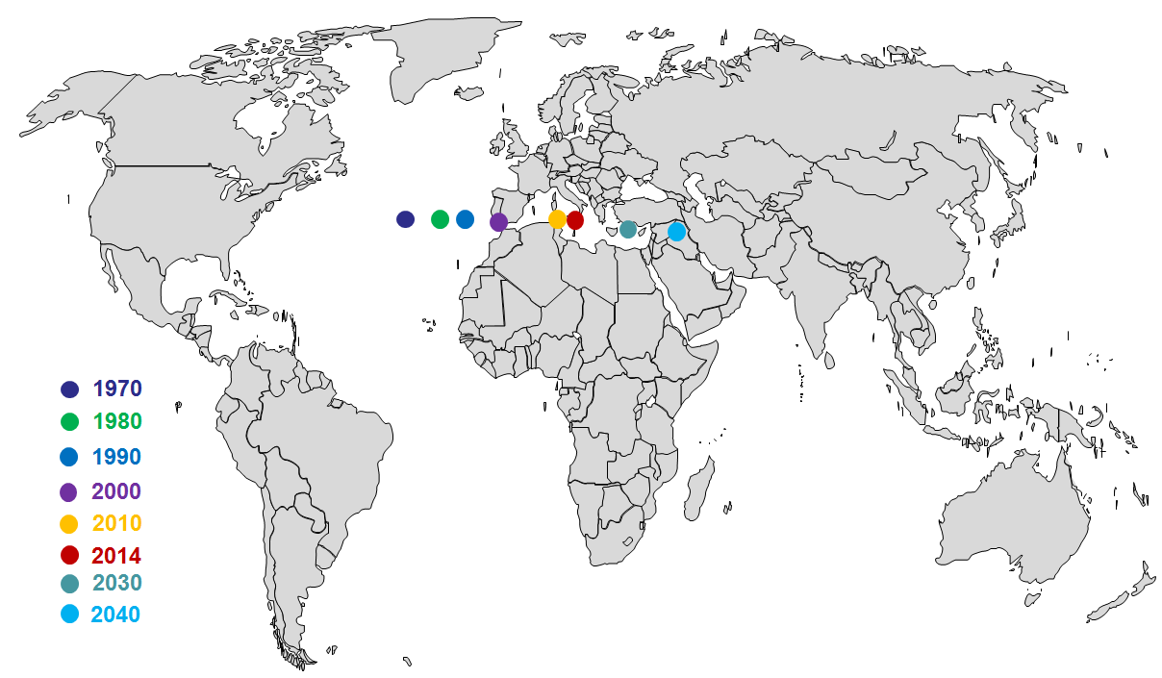
Centre of Gravity
The centre of gravity has been steadily moving from the middle of North Atlantic to the middle of the Mediterranean sea in the last four decades. It is expected to move further east by 2040.
Geographical centre of gravity of departing/arriving passengers
Source: ICAO
Notes:
The Geographical centre of gravity in terms of departing/arriving passengers is steadily moving further East to our Region. While this fact is well known the interesting thing to note is that the shift is happening much faster than before.
Increasingly Air Transport is becoming a significant contributor to the overall well-being and economic vitality of individual nations as well as the world in general. One of the keys to maintaining the vitality of civil aviation is to ensure that a safe, secure, efficient and environmentally sustainable air navigation system is available at the regional and national levels. This requires the implementation of an air traffic management system that allows maximum use to be made of enhanced capabilities provided by technical advances.

Slide 24
2016 Share of Revenue Tonne-Kilometres
Notes:
This Slide depicts pictorially the 2016 Percentage share of capacity (measured as Revenue Tonne Kilometers) by Region. APAC as you can see in yellow is leading.

Slide 25
Regional Accident Rates (2016) Scheduled Commercial above 5700kg for 2008 - 2016
Fatal Accidents in the APAC region: 3 (2015), 2 (2016)
Notes:
As mentioned earlier, regional accident rates remained low for 2016 in APAC. If you see three comparable regions in terms of departures i.e. APAC, Europe and Americas the accident rate is lowest for APAC
Specifically, APAC has had 2 fatal accidents in the region during 2016
---------------
NOTES:
2016-12-07 NEAR HAVELIAN (33NM NORTH WEST OF ISLAMABAD – PAKISTAN), Pakistan En route Accident with 47 Fatalities on a ATR ATR42 500 (reg. AP-BHO) operated by Pakistan International Airlines Corporation, Pakistan
2016-03-09 Crashed in the Bay of Bengal, Bangladesh Approach Accident with 3 Fatalities on a ANTONOV AN26 B (reg. S2-AGZ) operated by Ukraine , Ukraine

Slide 26
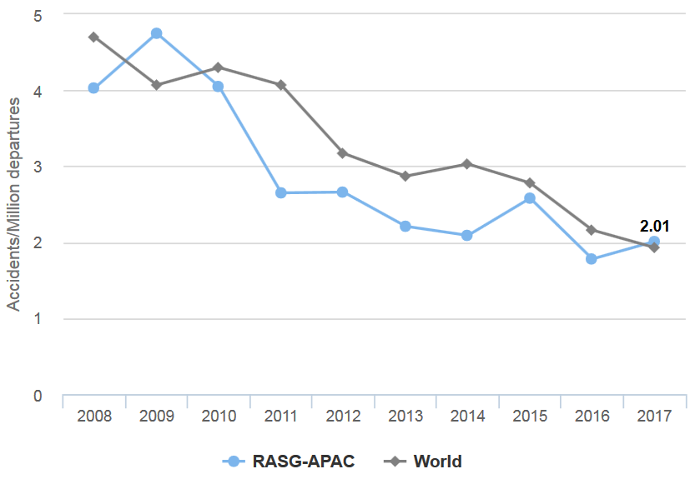
Global and APAC Accident Rates Scheduled Commercial above 5700kg for 2008 - 2017
Since 2010, APAC accident rate has been lower than the global.
However, 2017 showed a slightly higher average than the global average of 1.93*
Source: iSTARS 3.0 – Regional Safety Briefing (https://portal.icao.int/space)
Notes:
Looking at the trend since 2008, the accident rate of APAC in blue has been lower than the global rate since 2010. However, 2017 showed a slightly higher average than the global average of 1.93.

Slide 27
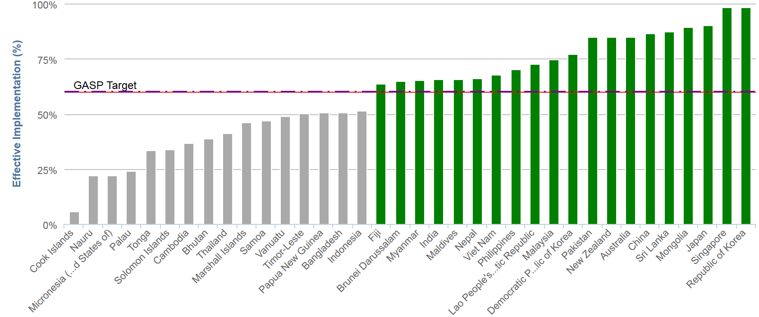
ICAO USOAP CMA results for APAC Effective implementation of safety oversight systems by State
* Latest Results:
Bangladesh: EI 75%
Indonesia: EI 80.34%
Global Average: 65.1%
Regional Average: 60.1% *
80%
75%
Source: iSTARS 3.0 – Regional Safety Briefing (https://portal.icao.int/space)
Notes:
The ICAO Universal Safety Oversight Audit Programme (USOAP) audits Contracting States, on a regular basis, to determine the States' capability for safety oversight. It makes this determination by assessing the effective implementation (EI) of the critical elements of a safety oversight system and the status of States' implementation of safety-related ICAO Standards and Recommended Practices (SARPs), This slide depicts the latest results of the Safety audits for APAC, where the APAC regional average EI is 60.1% currently, which is below the Global Average of 65%. The diversity of the region is very clearly shown in this slide where we have nearly 100 % EI scores by States like Singapore and Republic of Korea whereas some of the Pacific Island States are still below 20% EI
56% of the States in the region (20 of 36 Audited States) have achieved the GASP target of 60% EI. However once the recent audit results of Bangladesh and Indonesia are published, only 14 States will have a EI of below the GASP target of 60%.

Slide 28
Aviation Safety Priorities
Reduction of operational risks
Improvements to ICAO Safety Oversight/Industry Safety Audits
Predictive risk management and advanced regulatory oversight
Consistent and effective Safety Management Systems and State Safety Programmes
Enhanced Aviation Infrastructure (Air Traffic Services & Aerodrome)
Notes:
ASIA AND PACIFIC REGIONAL AVIATION SAFETY PRIORITIES AND TARGETS are established by the Regional Aviation Safety Group APAC. These five safety priorities in brief are as follows
Reduction of operational risks by addressing the priority areas of Loss of Control In-flight (LOC-I), Controlled Flight Into Terrain (CFIT) and Runway safety related accidents. RASG also continues its focus on the development of the current Safety Enhancement Initiatives, to address these three priority areas’.
2. Recognizing that the APAC region has one of the fastest air traffic growth rates and that effective safety oversight systems are crucial in ensuring high standards of safety, States should enhance their safety oversight system as a high priority through improvements to ICAO Safety Oversight and Industry Safety Audits. Specifically by :
Enhancing safety oversight systems through capacity building
According utmost priority in Resolving USOAP CMA Significant Safety Concerns (SSCs) or not to have any Significant Safety Concerns (SSCs)
Using the IATA Operational Safety Audit (IOSA) reports and other safety related assessments including those for ground operations
Achieving a USOAP EI score higher or equal to global average by 2022
3. Evolving a consistent and effective Safety Management Systems (SMS) and State Safety Programmes (SSP): Effective implementation of SMS is essential for the industry to identify hazards and resolve safety concerns. The robust implementation of the SSP also enables States to focus their safety oversight resources where they are most needed. Action required is for
Industry to implement SMS immediately and
States to implement effective SSP by 2025
4. The fourth priority is for enhanced Aviation Infrastructure i.e. (i) Air Traffic Services and Aerodrome Facilities: Sustainable growth of the international aviation system will require the introduction of advanced safety capabilities that increase capacity while maintaining or enhancing operational safety margins. The long-term safety objective is intended to support a collaborative decision making environment characterized by increased automation and the integration of advanced technologies on the ground and in the air, as contained in ICAO’s Aviation System Block Upgrades (ASBUs) strategy. Particular attention as stated earlier should be paid to runway safety. A large number of aerodromes in the APAC region are not certified due to lack of capacity of their respective regulatory authorities. We need to
support a collaborative decision making environment characterized by increased integration of advanced technologies on ground and in air
Facilitate aerodromes for international operations to have Runway Safety Teams (RSTs)
Certify all aerodromes used for international operations by 2020
5. And the last priority relates to Predictive risk management and advanced regulatory oversight: The evolution from reactive to predictive safety management and data-driven regulatory oversight systems hinges on the availability of high quality safety data. Proper risk management and oversight is also reliant on the effective investigation of accidents and incidents in order to prevent recurrence. As mentioned in the previous slide many APAC States have yet to fully implement ICAO Annex 13 requirements for accident investigation. Thus we need to
establish independent accident investigation authority and achieve AIG 60% of EI
establish a structure for safety data collection, analysis and sharing

Slide 29
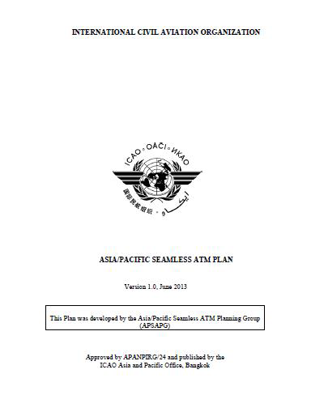
ICAO Asia/Pacific Seamless ATM Plan
A vision of an integrated, harmonized, and globally interoperable ATM System with a planning horizon up to and beyond 2025.
Objective: to facilitate Asia/Pacific Seamless ATM operations, by developing and deploying ATM solutions capable of ensuring safety and efficiency of air transport throughout the Asia/Pacific region.
Notes:
Currently - ANS implementation in Asia‐Pacific is guided by the ICAO APAC Seamless ATM Plan.
Historically APAC States / ANSPs had developed their own infrastructure tailored to suite their own national needs, and established future plans. There was no means of coordinated / harmonized ATM modernisation plans, like SESAR or NextGen.
The safety and efficiency of flights transcend national borders and airspace boundaries. Seamless ATM is therefore possible only if there is close regional collaboration among States, their ANSPs and all stakeholders. Cooperation is the key to success.
The 46th Directors General Civil Aviation (DGCA) Conference (Osaka, October 2009) was the genesis of Asia/Pacific Seamless ATM discussion. The DGCA Conference requested the Asia/Pacific Air Navigation Planning and Implementation Regional Group (APANPIRG) to take a lead role in development of Seamless ATM in the Asia/Pacific region.
This Plan was developed to address the full range of ATM stakeholders, including civil and military Air Navigation Services Providers (ANSPs), civil and military aerodrome operators as well as civil and military airspace users. The Plan has been developed in consultation with Asia/Pacific States, administrations and also with International Organizations (IO).
Given the size and diversity of the region, ATM harmonisation efforts will require the needs of the least developed ANSPs to be addressed especially in the areas of technical assistance such as funding, expertise and training. Differences in economic development may also mean that traffic demands are not uniform in the region, and therefore ATM solutions should be driven by performance requirements appropriate to the traffic demands.
APANPIRG developed the APAC Seamless ATM Plan, consistent with the ICAO Global ATM Operational Concept - a vision of an integrated, harmonized, and globally interoperable ATM System with a planning horizon up to and beyond 2025. The Objective of the regional plan is to facilitate Asia/Pacific Seamless ATM operations, by developing and deploying ATM solutions capable of ensuring safety and efficiency of air transport throughout the Asia/Pacific region.

Slide 30
Implementation - Key Issues
Rapid growth in air operators and aircraft fleet
Increased airspace and airport congestion
Insufficient resources to improve compliance with ICAO provisions
Slow progress of implementation of ATS infrastructure
Notes:
The key issues affecting APAC region relates to rapid growth, increased airspace and airport congestion, lack of resources and slow progress in modernization of ATS infrastructure.
Slow progress of implementation of ATS infrastructure, not corresponding to traffic growth, results in traffic delays at airports and in flight. It also leads to inefficient aircraft operations, environment concerns and safety issues

Slide 31
Factors causing the deficit
Insufficiency of training capacity to meet demand
Mismatch between number of new personnel to be trained each year with the annual training capacities of the existing training infrastructure,
Lack of awareness by the “next generation” of types of aviation professions available.
Learning methodologies –not responsive to new learning style
Aviation training/studies perceived to be expensive.
Lack of fellowships/sponsorships/incentives to support the growth
The additional demand for personnel (fueled by traffic increases and fleet expansion), coincides with predicted retirement waves.
.
Notes:
As you have seen in the previous slides training infrastructure is inadequate to meet the demands being generated by the growth in the region. We need to focus on the core issues affecting the projected deficit of manpower. A career in aviation is not very attractive and aspirational to the new generation, the learning methodologies needs radical changes to meet new challenges and aviation training is very expensive making it out of reach for most aspirants. State incentives and support from industry to the training institutions like tax holidays, infrastructure grant, limited campus recruitment etc. inhibit the growth of this important sector in the aviation eco-system. Most industries and regulators donot have a robust long term succession planning strategy leading to seasonal imbalances in supply and demand of manpower.

